Slide 1
Eclectic Eats Haven
CSET 120
Final Project– Fall 2023
Zachary short
Katy shi

Slide 2
Introduction
Title: Eclectic Eats Haven
A user-friendly restaurant website designed for the convenience of ordering.

Slide 3
Introduction (cont.)
Title: Software Requirements Specification (SRS)
A document that outlines the features of the software
Key components
Maintainable – The website should be easy to maintain and update as needed.
Portable – The website should be able to adapt to different browsers and screen sizes.
Reliable – The website should be reliable so that customers will want to order from the website, and the manager will use the website and want to update the menu.
Secure – the website should be secure. The user password will be hashed.
Provide a website for a restaurant where the manager can manage the menu.
Customers can place orders from the online menu, pay for their order online, and view their order receipt. They can also print their order receipt.
User-friendly layout to navigate through the website.

Slide 4
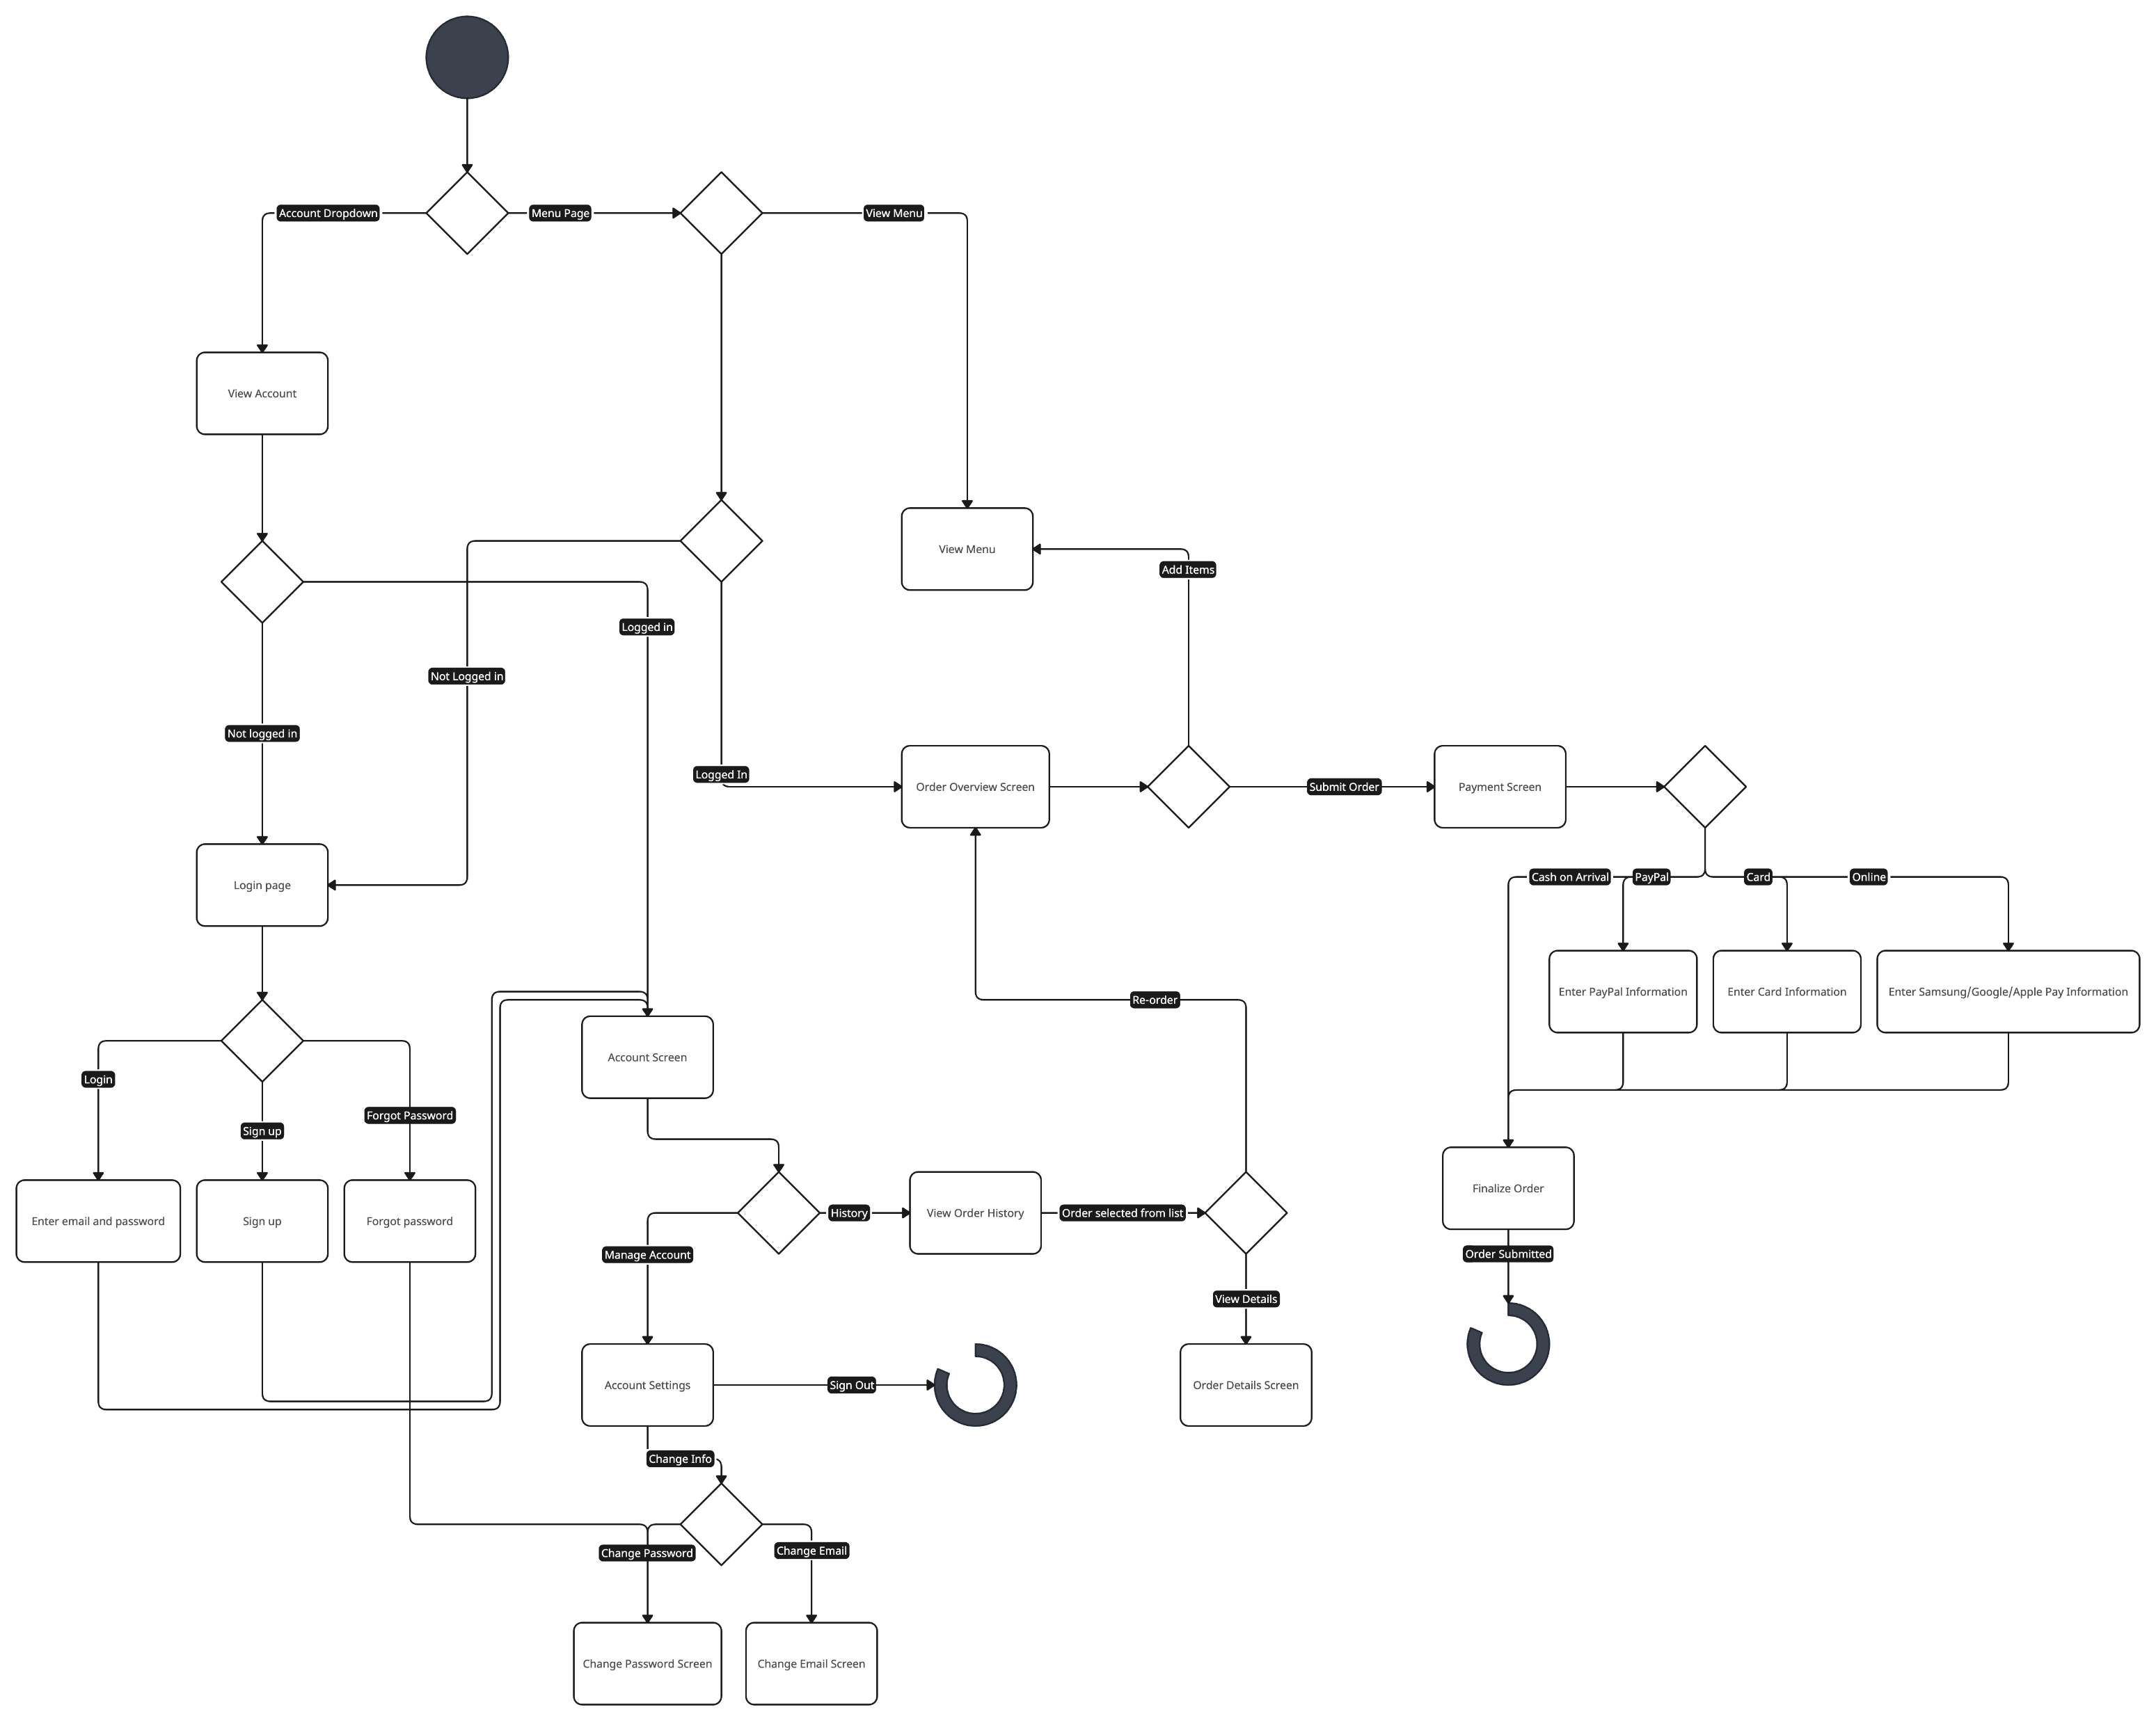
Activity Diagram

Slide 5
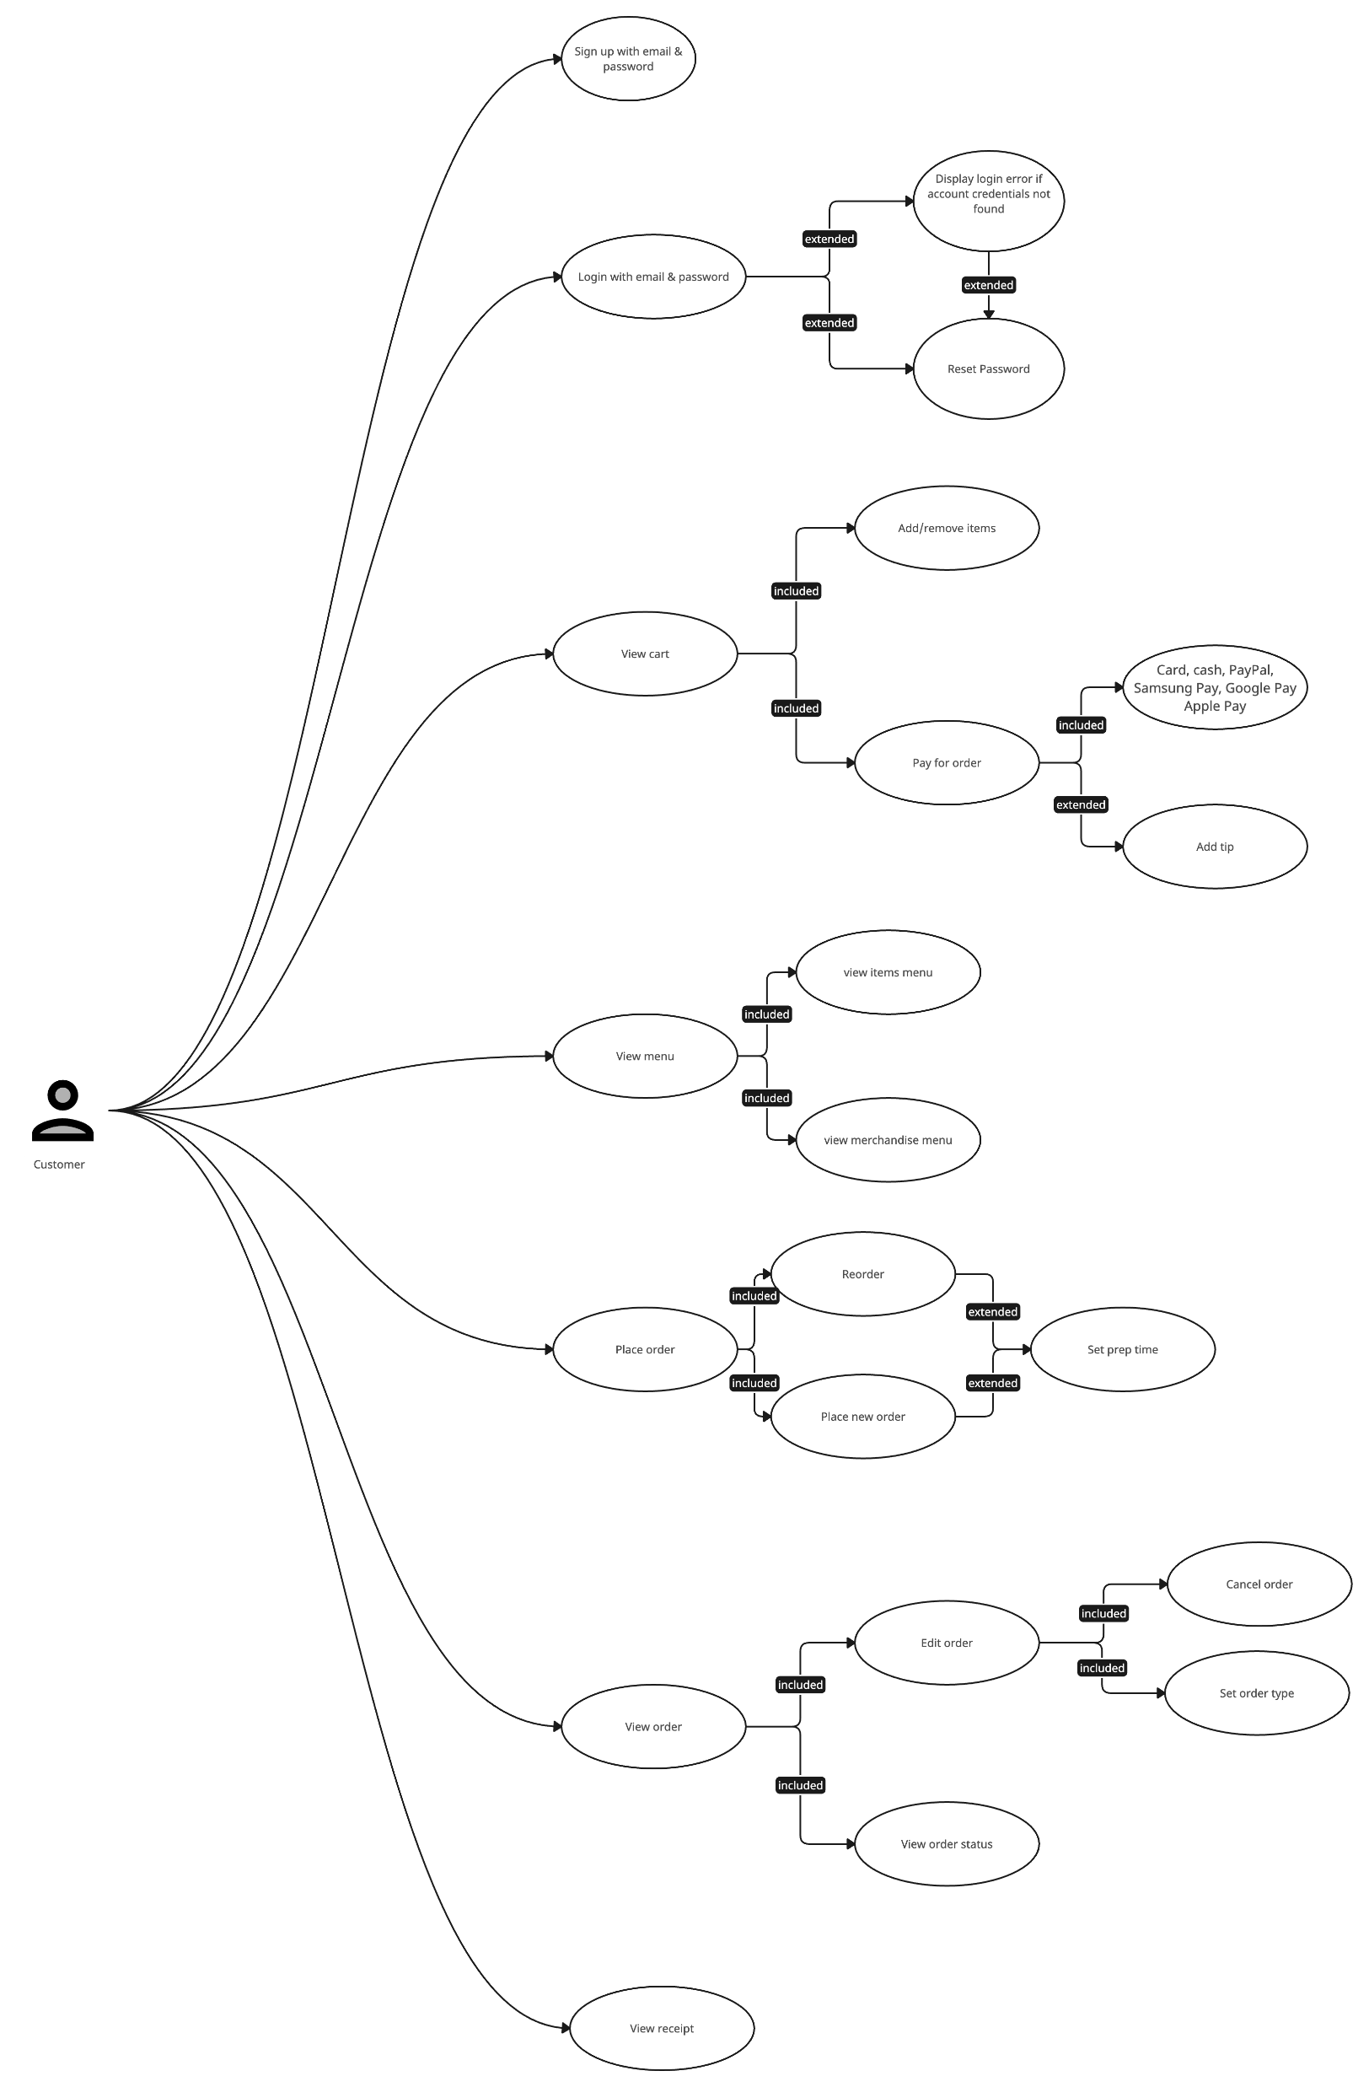
Use Case Diagram

Slide 6
User Authentication Module
Sign-up page for customers
Login page for customers and managers

Slide 7
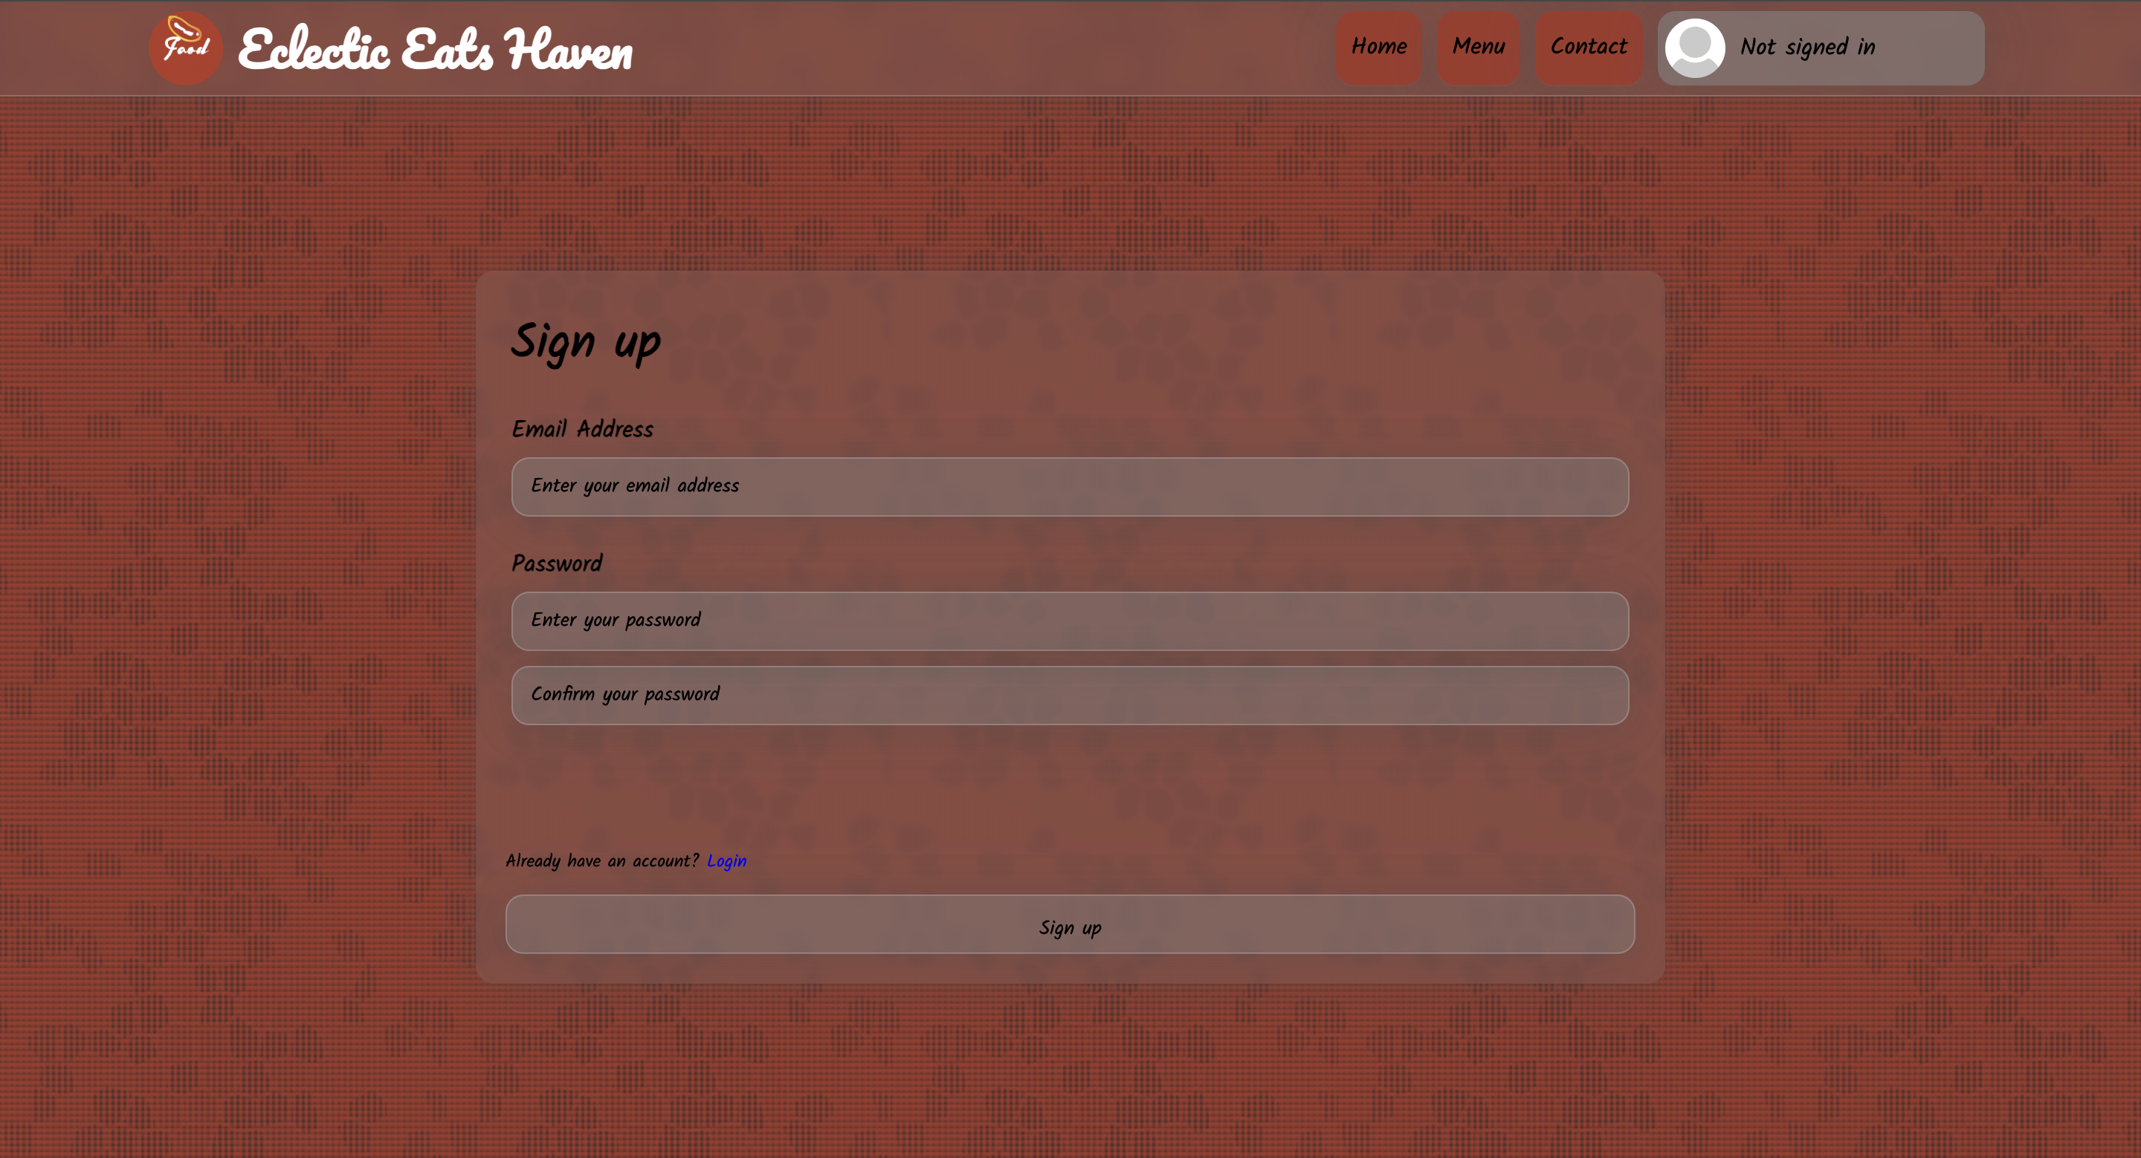
User Authentication Module (cont.)
Sign-up page for customers

Slide 8
User Authentication Module (cont.)
Sign-up page for customers
Create an account using desired email and password
Hashed password for security
Email and password are stored for login purposes
Logged in after signing up
Redirected to account management page

Slide 9
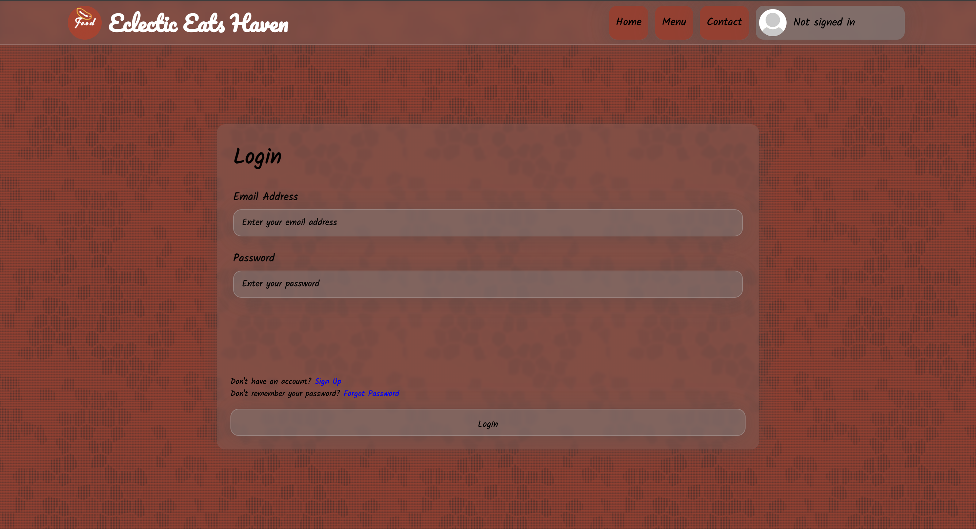
User Authentication Module (cont.)
Login page for customers and managers

Slide 10
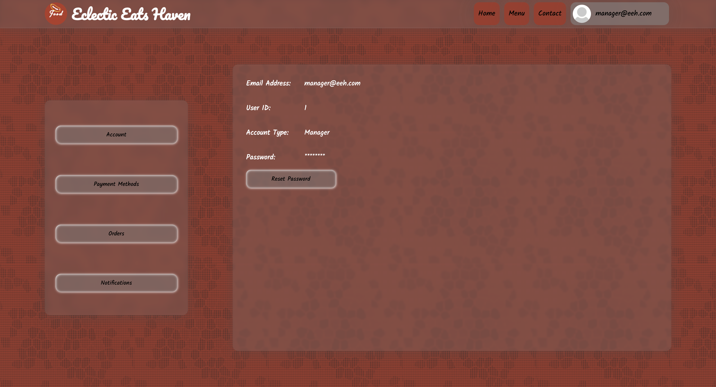
User Authentication Module (cont.)
Account management page

Slide 11
User Authentication Module (cont.)
Login page for customers and managers
After creating an account, users can login with their email and password.
After logging in, user is brought to the account management page

Slide 12
User Authentication Module (cont.)
Forgot Password Page
Enter the email associated to the account to reset the password.
Since we cannot actually send an email, the password is set to “12345678”

Slide 13
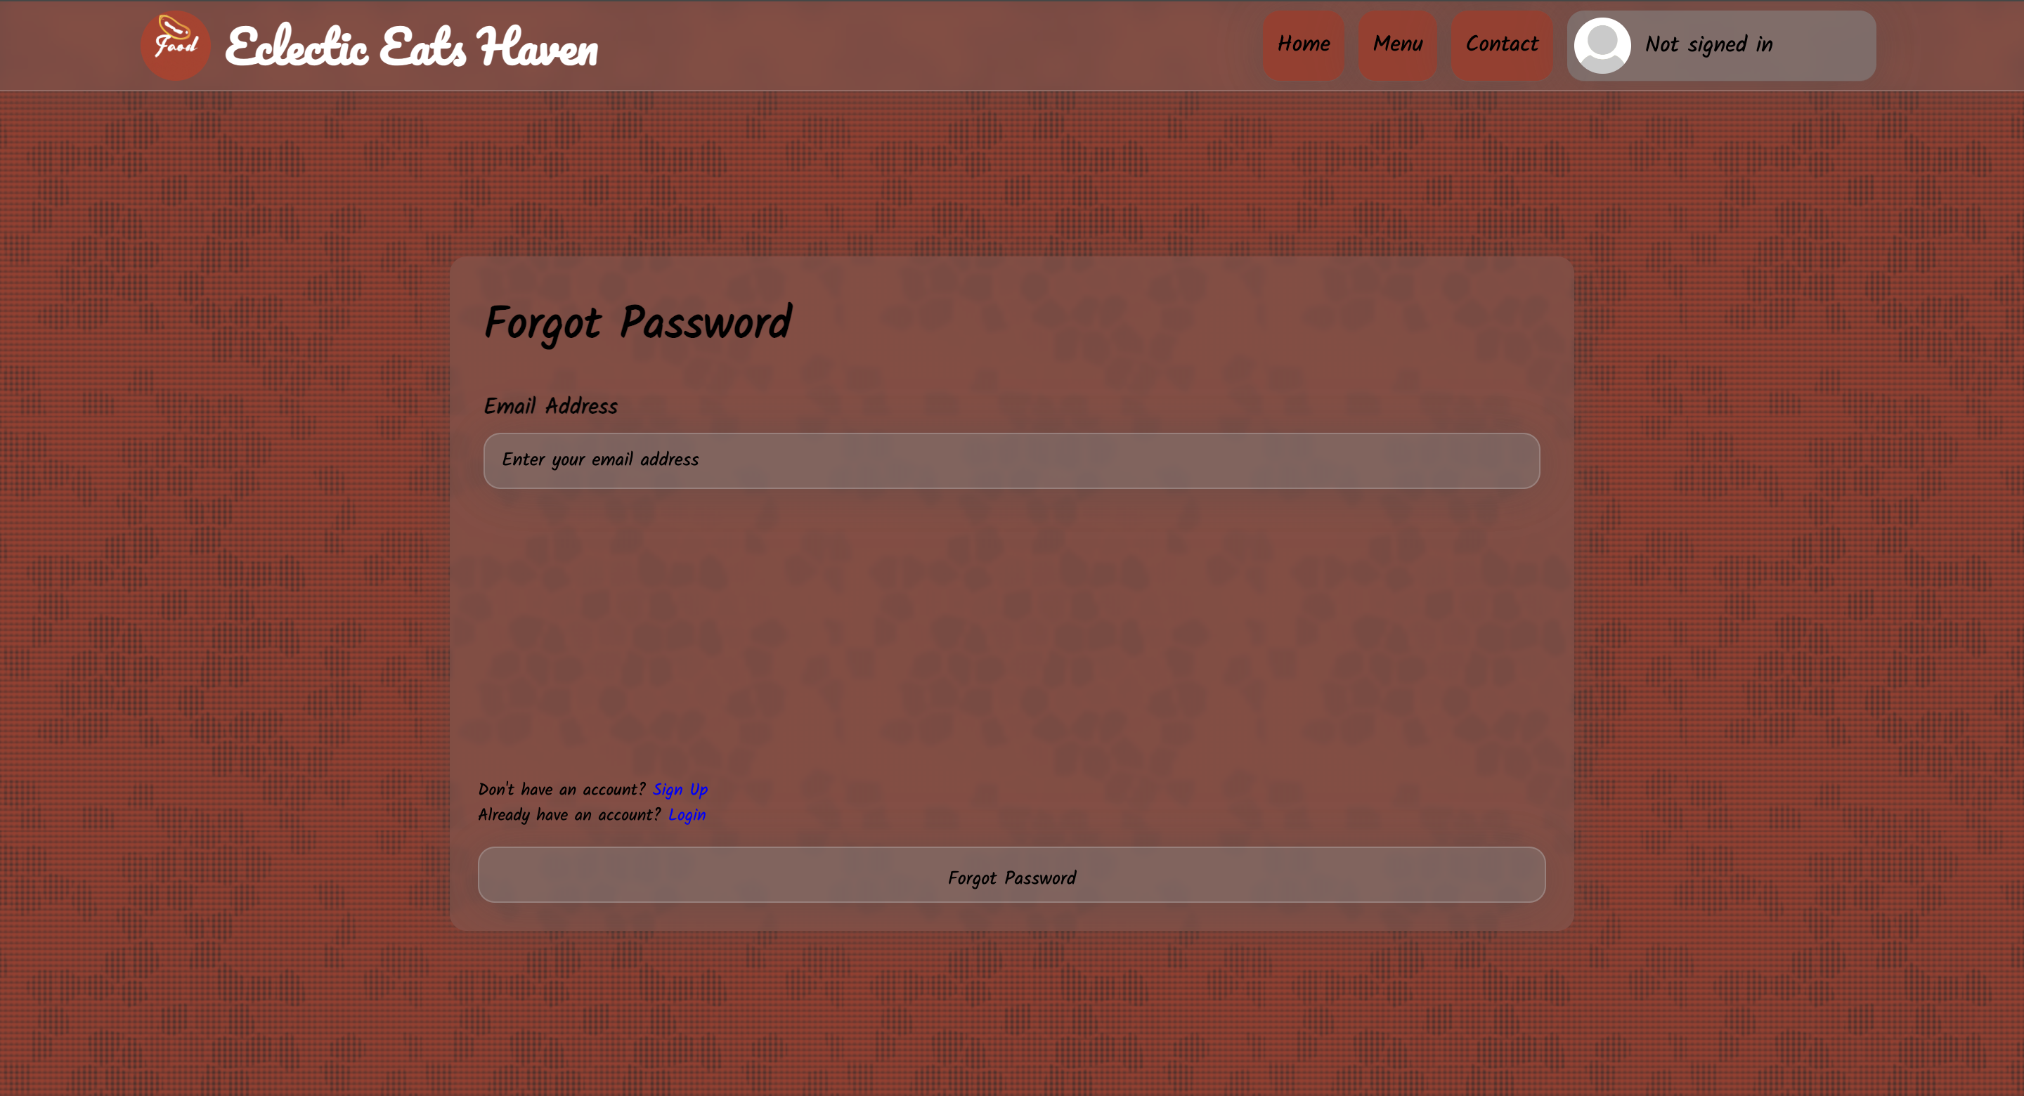
User Authentication Module (cont.)
Forgot Password Page

Slide 14
Menu Display Module
Menu page
User-friendly interface and navigation

Slide 15
Menu Display Module (cont.)
Menu Page
Features seven categories each with four items
Items each feature an image
Customizable toppings before adding the item to the cart

Slide 16
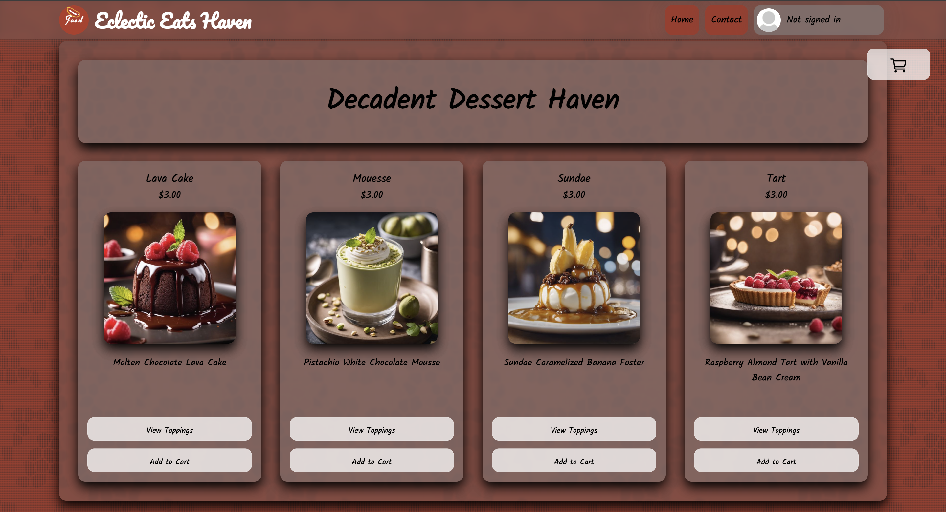
Menu Display Module (cont.)
Menu Page

Slide 17
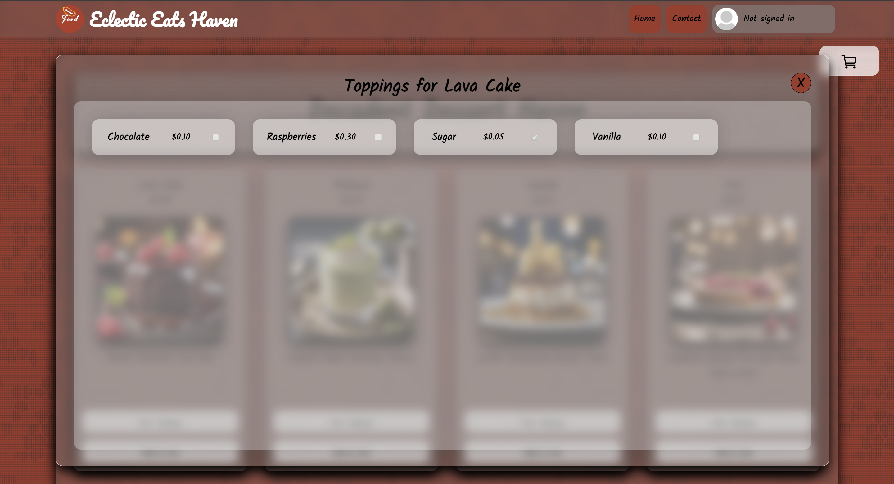
Menu Display Module (cont.)
Menu Page - toppings page

Slide 18
Ordering Process
Final cart page for order review & payment options
Receipt and order details page

Slide 19
Ordering Process
Final cart page for order review & payment options
Customizable toppings when item is in the cart
Cart order review section displays the item, toppings, quantity, and price of each item
Customer can directly increase the quantity of the item and remove the item
Cart displays the subtotal, tax, and total of the order along with a tips section
Choose a payment method and be redirected to a payment page depending on which payment method was chosen

Slide 20
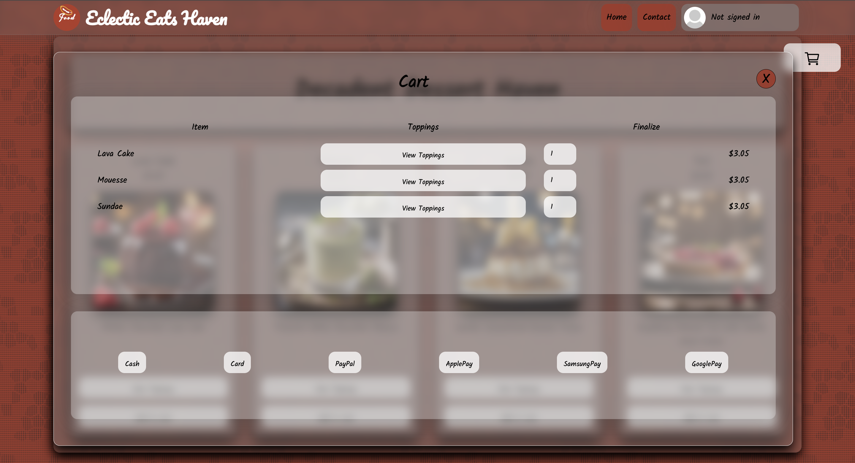
Ordering Process
Final cart page for order review & payment options

Slide 21
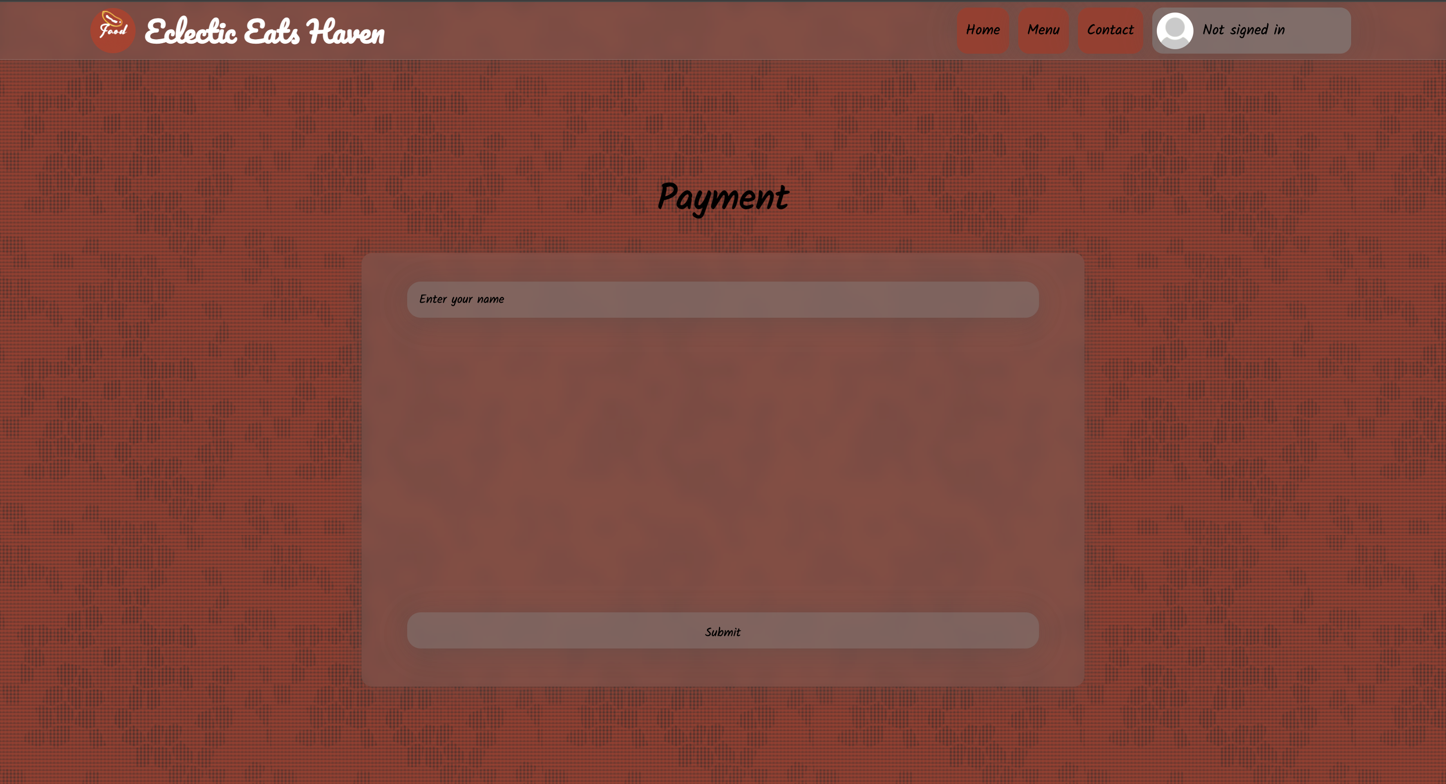
Ordering Process
Cash/PayPal/Apple Pay/Samsung Pay/Google Pay payment page layout

Slide 22
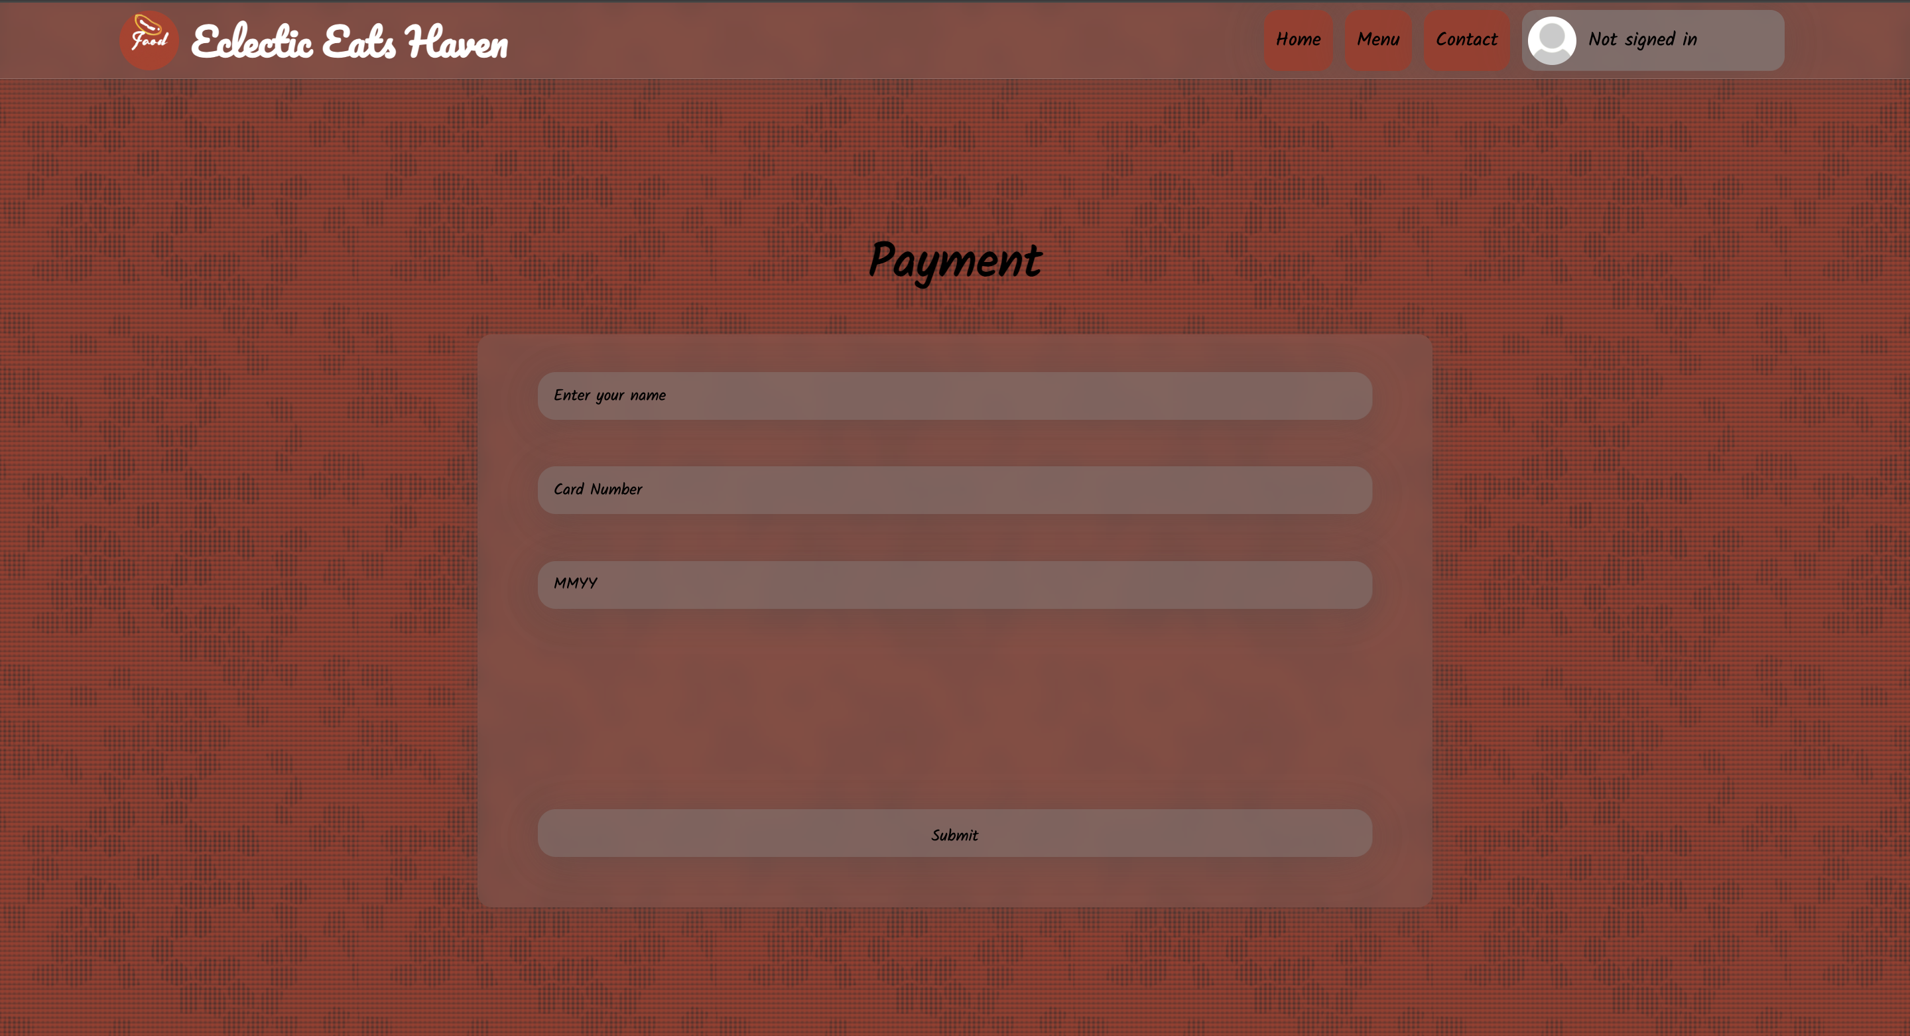
Ordering Process
Card payment page

Slide 23
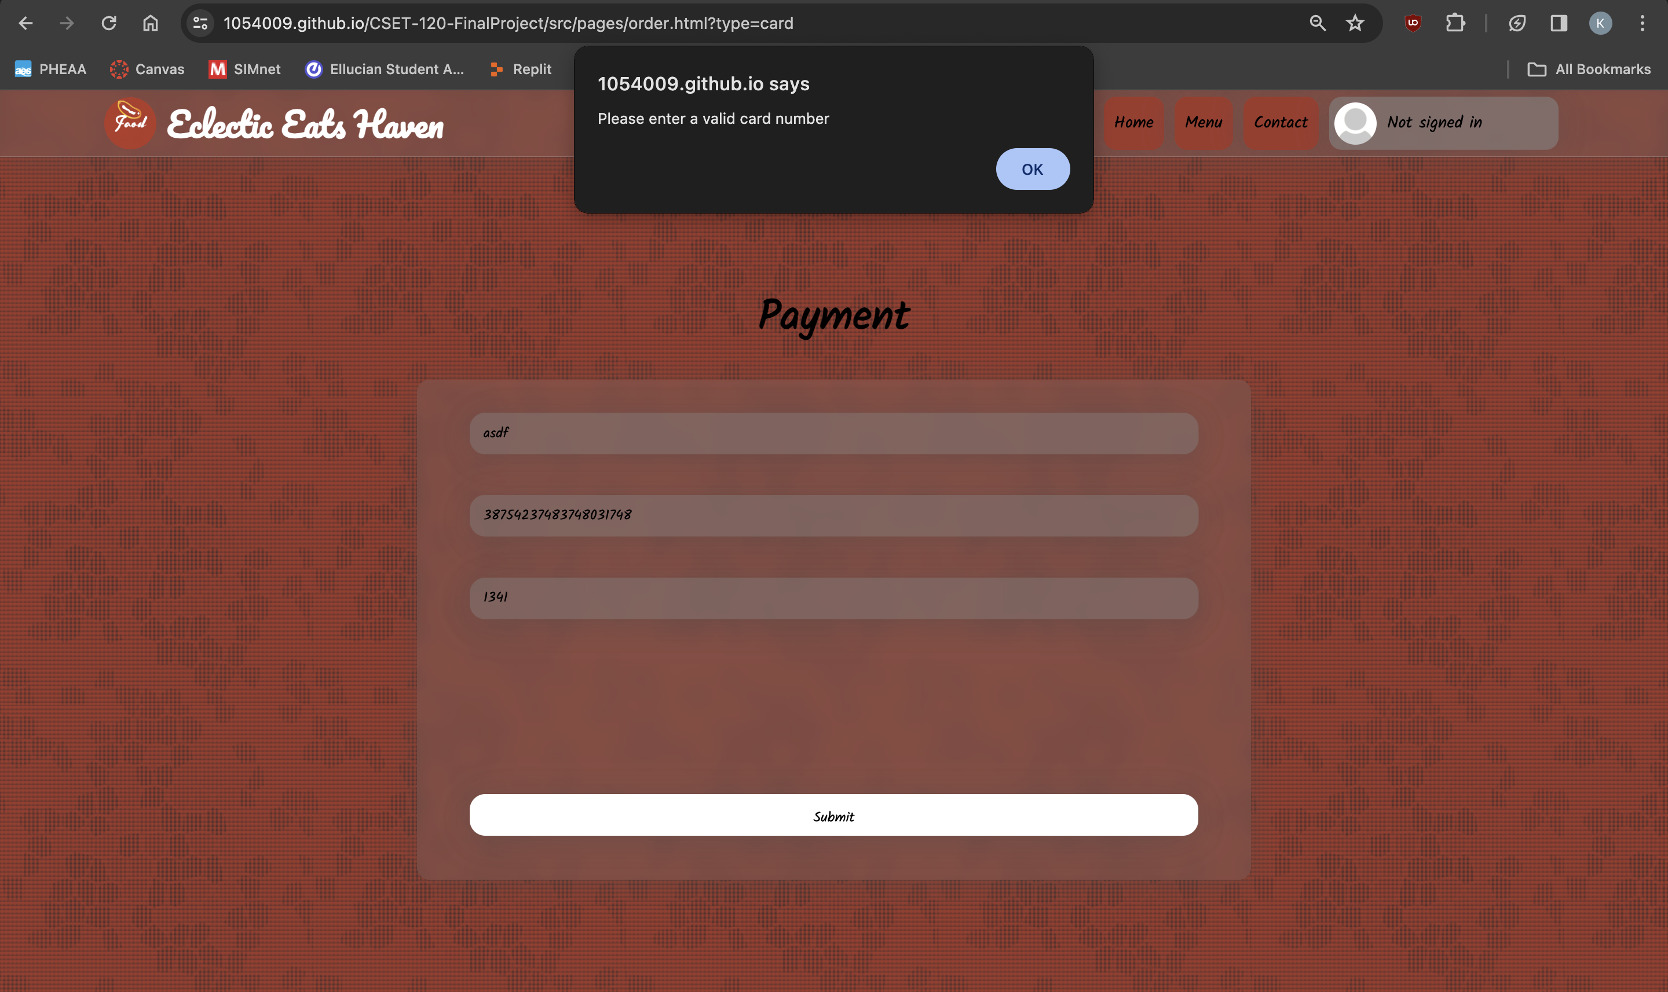
Ordering Process
Card payment page – card validation

Slide 24
Ordering Process
Receipt and order details page
Shows the item name, selected toppings of the items, quantity, and price of each item
Includes the customer’s name and email
Features the order number and payment method
Gives the customer an estimated time of when the order will be completed

Slide 25
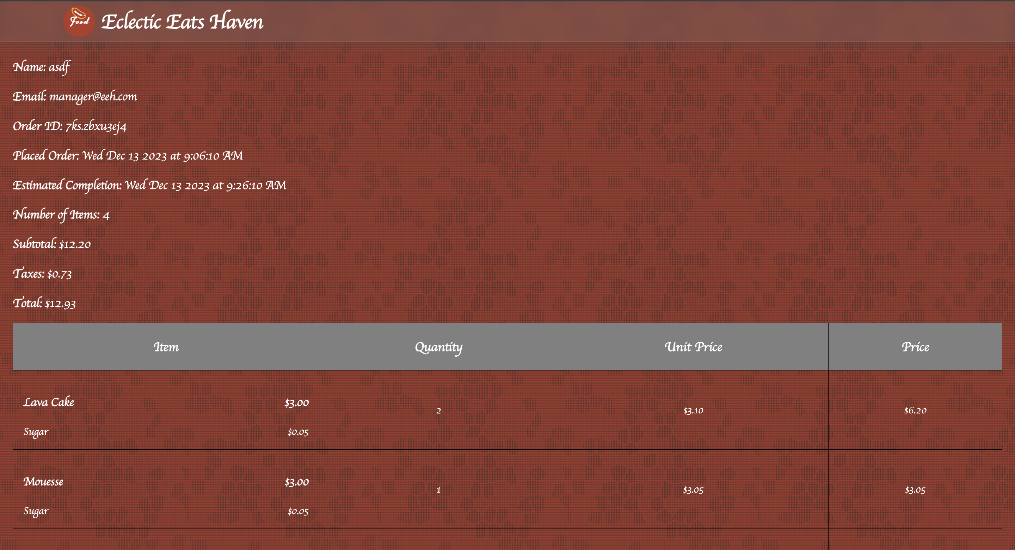
Ordering Process
Receipt page

Slide 26
Manager Functions
Manager’s menu page

Slide 27
Manager Functions
Manager’s menu page
Enable and disable items and toppings
Change price of items and toppings

Slide 28
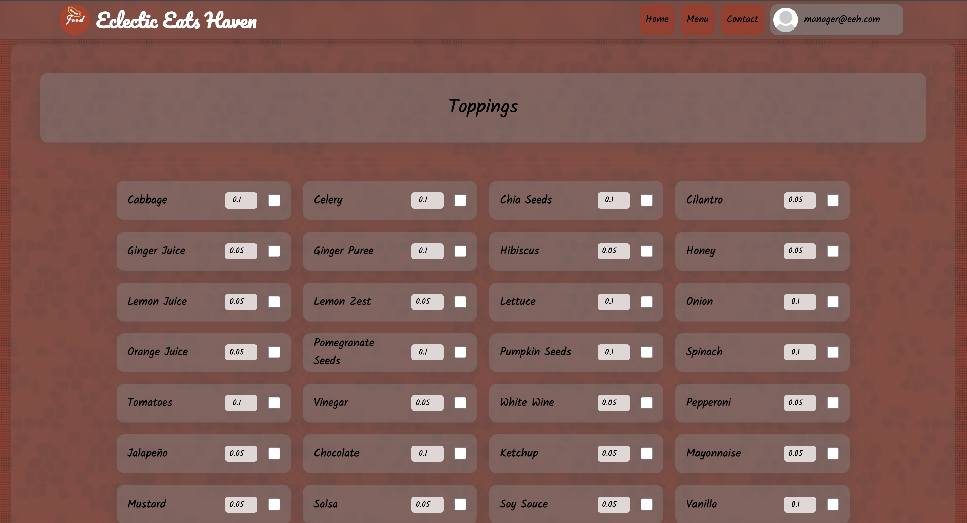
Manager Functions
Manager’s menu page

Slide 29
GitHub Repository
Project name: CSET-120-FinalProject
Team members: Zachary Short, Katy Shi
GitHub Repository

Slide 30
Trello Agile Board
Usage: used to keep track of what was completed and what needed to be completed
Tasks are organized based on functionalities (the different pages, customer controls, manager controls)

Slide 31
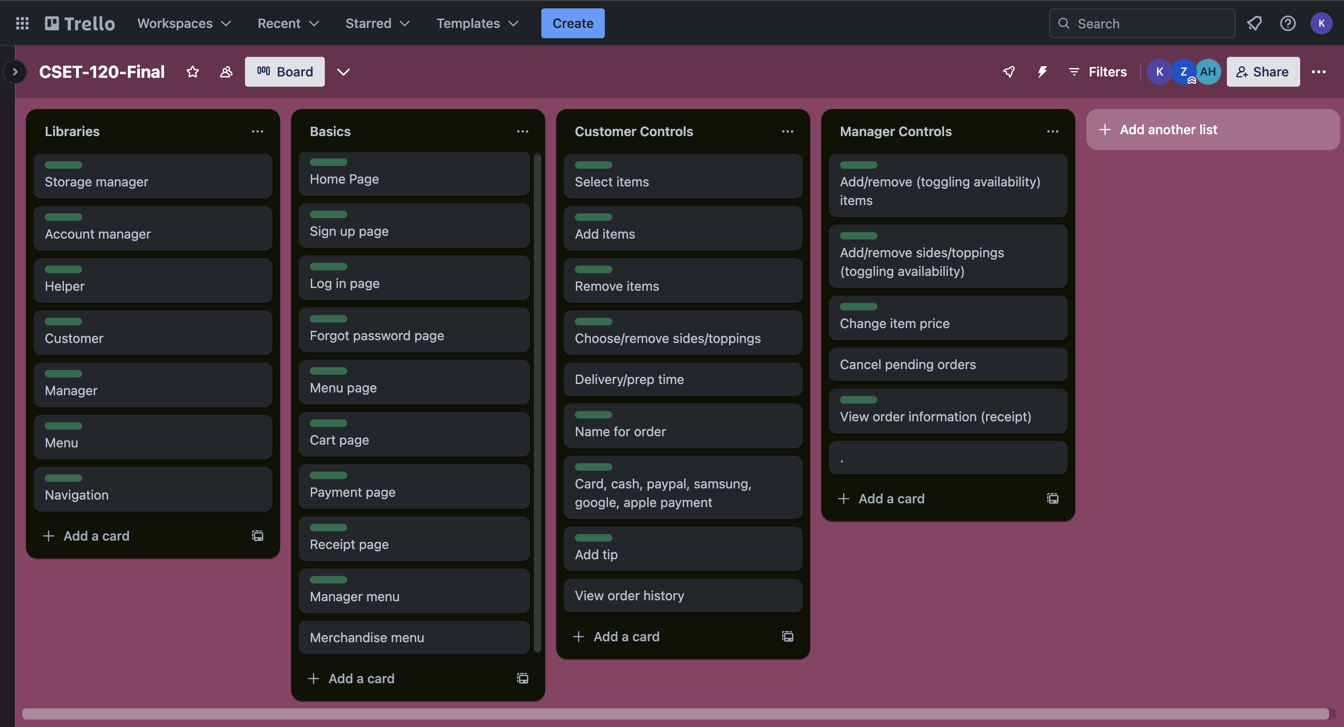
Trello Agile Board (cont.)

Slide 32
Project Timeline
Importance of pre-coding planning: planned out what functionalities we wanted

Slide 33
Project Timeline (cont.)
Week 1 (Nov 15 - Nov 18)
Katy
completed most of the SRS
Zach
started setting up the libraries (Account manager, storage manager, helpers)
set up navbar
worked on account login/signup/forgot password page

Slide 34
Project Timeline (cont.)
Week 2 (Nov 19 - Nov 25)
Katy
made About and Contact section of Home page
started on creating menu items and toppings
Zach
worked on navigation manager for navbar
finished account page

Slide 35
Project Timeline (cont.)
Week 3 (Nov 26 - Dec 2)
Katy
added images for menu items
worked on adding more items and toppings
worked on header section of home page
started creating the menu page (items and toppings)
Zach
set up actual account page (after logged in)
more account manager
started making classes

Slide 36
Project Timeline (cont.)
Week 4 (Dec 3 - Dec 9)
Katy
worked on setting up the cart, totals & tips, and payment method section
Implemented close buttons for toppings list and cart section
Started on the payment page
Worked on handling item duplicates and storing cart items using sessionStorage, although doesn’t restore cart when page refreshed
Zach
deleted classes
set up orders history page on account management
worked on manager menu library for toggling availability of items and toppings
changed how accounts are stored
worked on card validation

Slide 37
Project Timeline (cont.)
Week 5 (Dec 10 - Dec 13)
Katy
worked on presentation slides
worked on payment section and receipt
set up display for manager menu
Zach
re-creating entire menu code
linked payment, receipt, and manager menu up to new menu code

Slide 38
Conclusion
Summarize key points from the presentation
A user-friendly website adapted to different screen sizes
Friendly navigation
Features login/sign-up/forgot password pages
Allow password resetting on account management page
Add to/remove from cart easily
Various payment options
Printable receipt
Toggle of availability of items/toppings

Slide 39
Thank You!
Questions?

